Slide 1
Project meeting (2016-11-28) - DVA313
Created by: Group 2 – Solar energy calculator

Slide 2
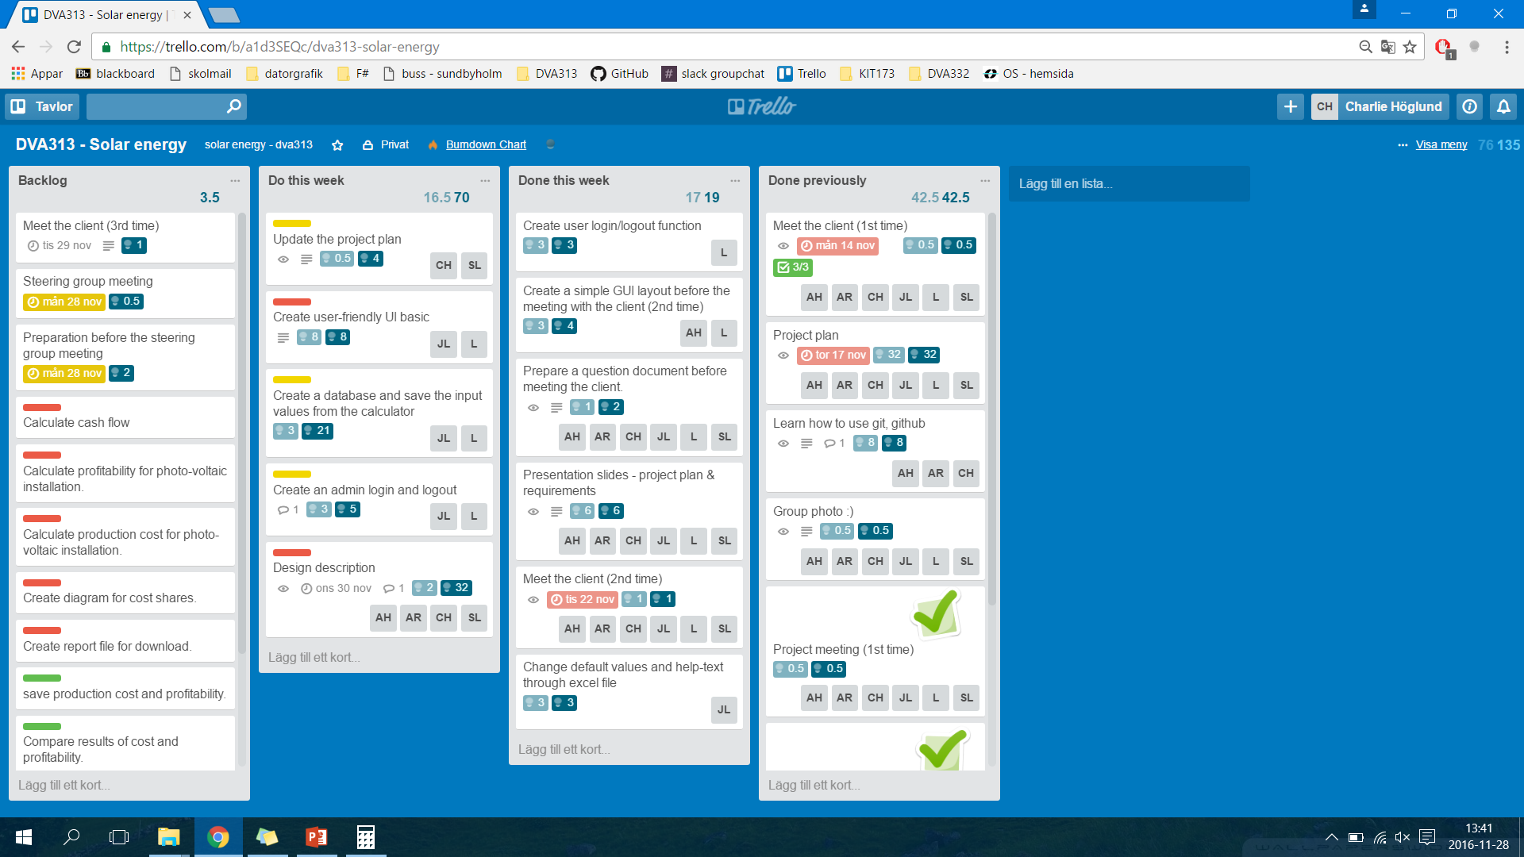
Trello board – Week 47 (previous)

Slide 3
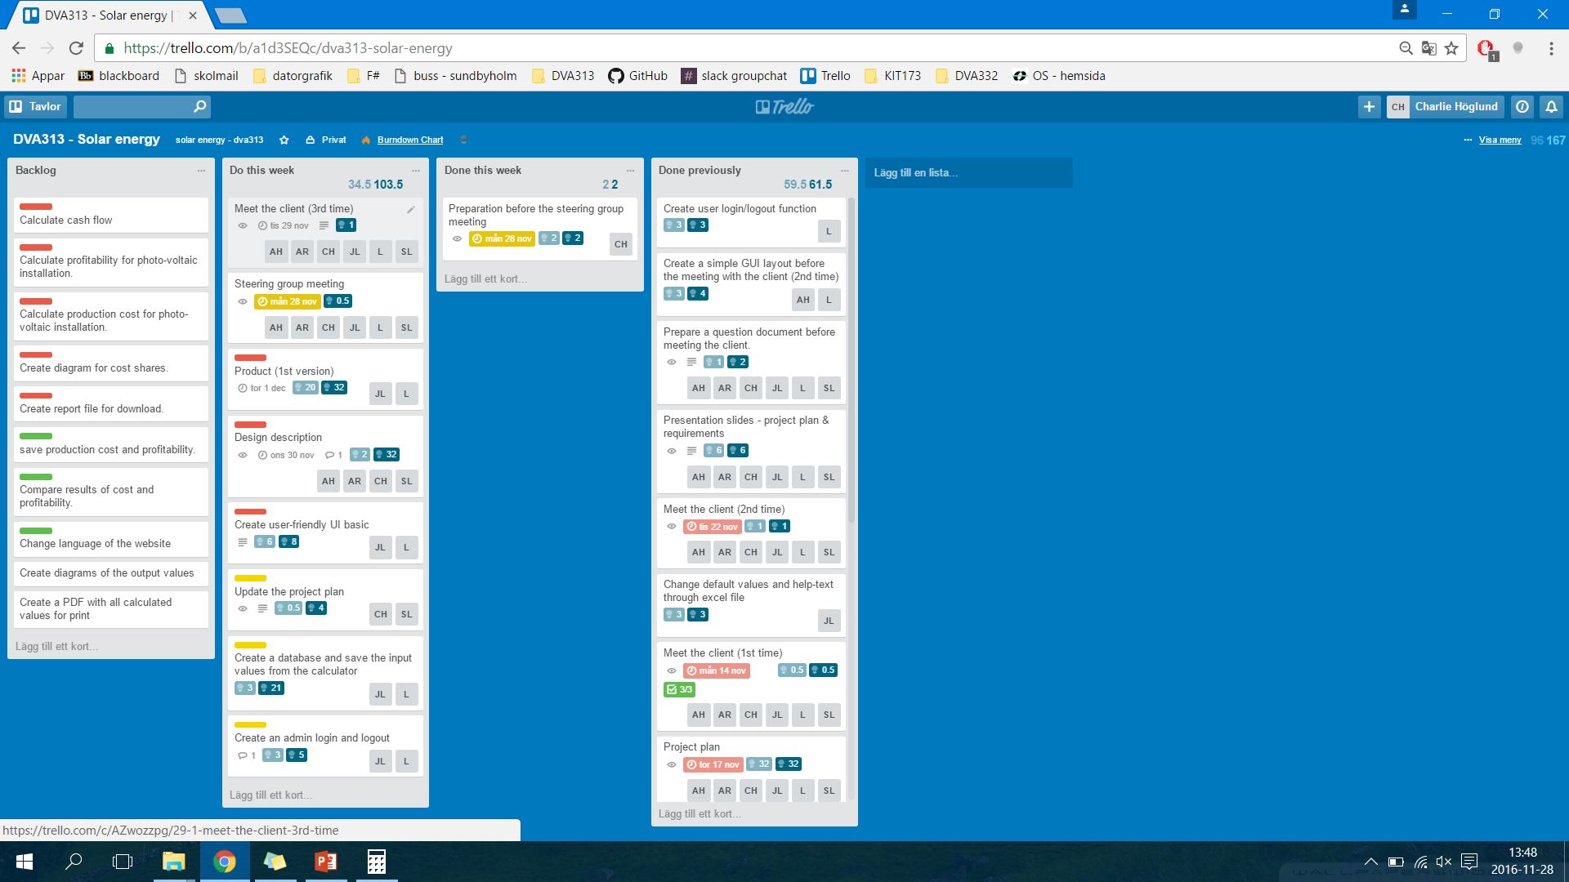
Trello board – Week 48 (present)

Slide 4
Any obstacles, risks or issues that have been identified
None at the moment.

Slide 5
Worked hours for each member
Name | Week 1 (hours) | Week 2 (hours) | Week 3 (hours) | Total
Lukas Hamacek | 6 | 18 | 10 | 34
Aliya Hussain | 7 | 16 | 9 | 32
Charlie Höglund | 8 | 20 | 13.5 | 41.5
Jonathan Larsson | 6 | 13 | 19.5 | 38.5
Sebastian Lindgren | 12.5 | 16.5 | 13 | 42
Avalika Reddy | 6 | 13 | 9 | 28

Slide 6
Questions for the steering group
When does the updated project plan has to be delivered (deadline)?
Design description – only write as much as we can (1st version)?
Any remarks regarding our implemented website so far?

